Slide 1
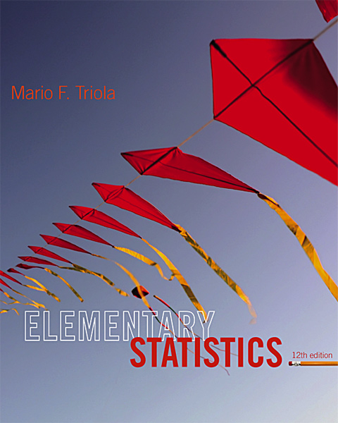
Lecture Slides
Elementary Statistics
Twelfth Edition
and the Triola Statistics Series
by Mario F. Triola

Slide 2
Chapter 6
Normal Probability Distributions
6-1 Review and Preview
6-2 The Standard Normal Distribution
6-3 Applications of Normal Distributions
6-4 Sampling Distributions and Estimators
6-5 The Central Limit Theorem
6-6 Assessing Normality
6-7 Normal as Approximation to Binomial

Slide 3

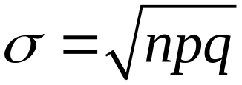
Key Concept
This section presents a method for using a normal distribution as an approximation to the binomial probability distribution.
If the conditions of np ≥ 5 and nq ≥ 5 are both satisfied, then probabilities from a binomial probability distribution can be approximated well by using a normal distribution with mean and standard deviation:

Slide 4
Review
Binomial Probability Distribution
1. The procedure must have a fixed number of trials.
2. The trials must be independent.
3. Each trial must have all outcomes classified into two categories (commonly, success and failure).
4. The probability of success remains the same in all trials.
Solve by binomial probability formula, Table A-1, or technology.
Notes:
A review of necessary requirements for a binomial probability distribution.
page 214 of Elementary Statistics, 10th Edition

Slide 5


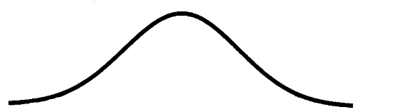
Approximation of a Binomial Distribution with a Normal Distribution
then , and the random variable has
a
distribution.
(normal)

Slide 6
Procedure for Using a Normal Distribution to Approximate a Binomial Distribution
1. Verify that both and . If not, you must use software, a calculator, a table or calculations using the binomial probability formula.
Find the values of the parameters μ and σ by calculating:
3. Identify the discrete whole number x that is relevant to the binomial probability problem. Focus on this value temporarily.

Slide 7
Procedure for Using a Normal Distribution to Approximate a Binomial Distribution
4. Draw a normal distribution centered about μ, then draw a vertical strip area centered over x. Mark the left side of the strip with the number equal to x – 0.5, and mark the right side with the number equal to x + 0.5. Consider the entire area of the entire strip to represent the probability of the discrete whole number itself.
5. Determine whether the value of x itself is included in the probability. Determine whether you want the probability of at least x, at most x, more than x, fewer than x, or exactly x. Shade the area to the right or left of the strip; also shade the interior of the strip if and only if x itself is to be included. This total shaded region corresponds to the probability being sought.

Slide 8
Procedure for Using a Normal Distribution to Approximate a Binomial Distribution
6. Using x – 0.5 or x + 0.5 in place of x, find the area of the shaded region: find the z score, use that z score to find the area to the left of the adjusted value of x. Use that cumulative area to identify the shaded area corresponding to the desired probability.

Slide 9
Example – NFL Coin Toss
In 431 NFL football games that went to over time, the teams that won the coin toss went on to win 235 of those games.
If the coin-toss method is fair, teams winning the toss would win about 50% of the games (we’d expect 215.5 wins in 431 overtime games).
Assuming there is a 0.5 probability of winning a game after winning the coin toss, find the probability of getting at least 235 winning games.

Slide 10
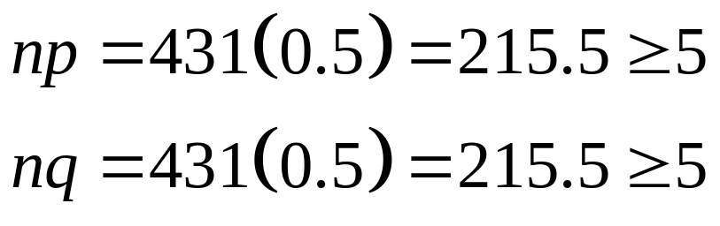
Example – NFL Coin Toss
The given problem involves a binomial distribution with n = 431 trials and an assumed probability of success of p = 0.5.
Use the normal approximation to the binomial distribution.
Step 1: The conditions check:

Slide 11
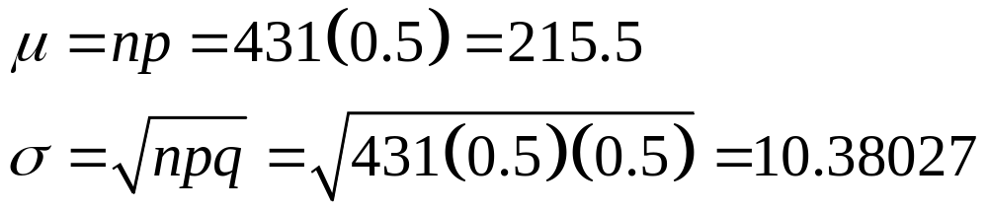
Example – NFL Coin Toss
Step 2: Find the mean and standard deviation of the normal distribution:
Step 3: We want the probability of at least 235 wins,
so x = 235.
Step 4: The vertical strip will go from 234.5 to 235.5.

Slide 12
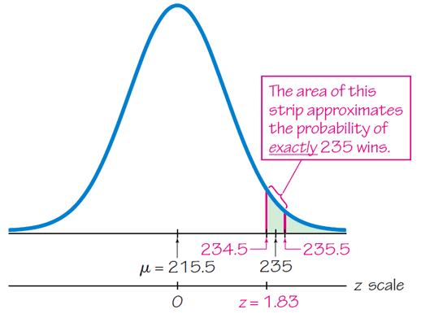
Example – NFL Coin Toss
Step 5: We will shade the area to the right of 234.5.

Slide 13
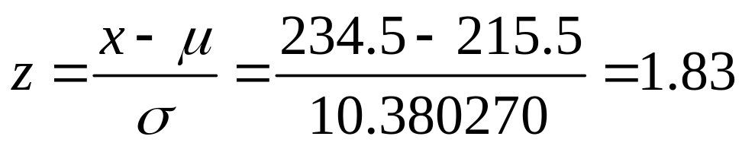
Example – NFL Coin Toss
Step 6: Find the z score and use technology or Table A-2 to determine the probability.
The probability is 0.0336 for the coin flip winning team to win at least 235 games.
This probability is low enough to suggest the team winning coin flip has an unfair advantage.

Slide 14
Definition
When we use the normal distribution (which is a continuous probability distribution) as an approximation to the binomial distribution (which is discrete), a continuity correction is made to a discrete whole number x in the binomial distribution by representing the discrete whole number x by the interval from
x – 0.5 to x + 0.5
(that is, adding and subtracting 0.5).
Notes:
page 295 of Elementary Statistics, 10th Edition

Slide 15
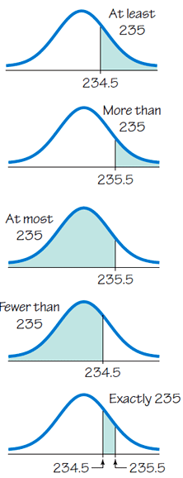
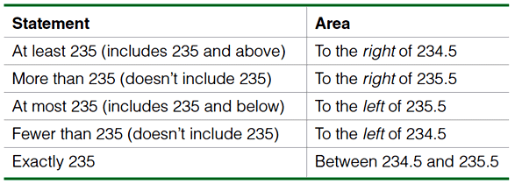
Example – Continuity Corrections

